Slide 1
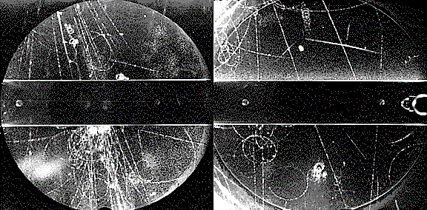
Lecture #6
Prof. Dr. Florencia Canelli
Universität Zürich
Elementary particle physics - PHY451
HS2016

Slide 2
Symmetries
A symmetry is a change of something that leaves the physical description of the system unchanged.
Physical symmetries:
People are approximately bilaterally symmetric
Spheres have rotational symmetries
Laws of nature are symmetric with respect to mathematical operations, that is: an observer cannot tell whether or not this operation has occurred

Slide 3
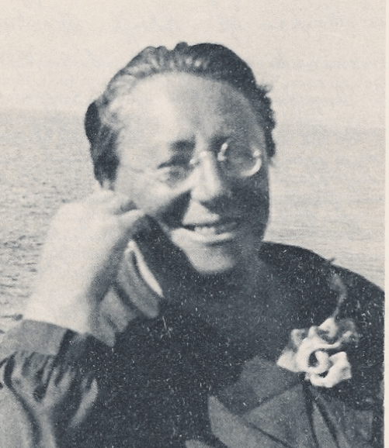
Continuous symmetries and conservation laws
In classical mechanics we have learned that to each continuous symmetry transformation, which leaves the scalar Lagrange density invariant, can be attributed a conservation law and a constant of movement (E. Noether, 1915)
Continuous symmetry transformations lead to additive conservation laws
E. Noether
Symmetry | Invariance under movement in time | Homogeneity of space | Isotropy of space
Transformation | Translation in time | Translation in space | Rotation in space
Conserved quantity | Energy | Linear momentum | Angular momentum
No evidence for violation of these symmetries seen so far

Slide 4
Symmetry of reference frames
Another type of symmetry has to do with reference frames moving with respect to one in which the laws of physics are valid (inertial reference frames):
Note that while laws are unchanged between reference frames, quantities are not
The fact that the laws of motion are unchanged between frames, plus the fact that the speed of light is always the same lead to the theory of special relativity with two consequences
Two events that are simultaneous in one reference frame are not necessarily simultaneous in a reference frame moving with respect to it
There are some quantities (called Lorentz scalars) that have values independent of the reference frame in which their value is calculated
Physical laws are unchanged when viewed in any reference frame moving at constant velocity with respect to one in which the laws are valid

Slide 5
Symmetry in quantum mechanics
In general, if U is a symmetry of the Hamiltonian H, one has:
The associated quantum numbers are conserved (selection rules)
Accordingly, the Standard Model Lagrangian satisfies local gauge symmetries (the physics must not depend on local (and global) phases that cannot be observed):
U(1) gauge transformation | ➔ | Electromagnetic interaction
SU(2) gauge transformation | ➔ | Weak interaction
SU(3)_{C} gauge transformation | ➔ | Strong interaction (QCD)
Conserved additive quantum numbers:
Electric charge (processes can move charge between quantum fields, but the sum of all charges is constant)
Color charge of quarks and gluons, and the weak charge
Quark (baryon) and lepton numbers (however, no theory for these, therefore believed to be only approximate asymmetries) → evidence for lepton flavor violation in “neutrino oscillation”

Slide 6
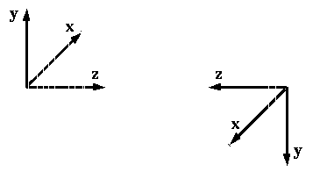
Discrete symmetries
Discrete symmetry transformations lead to multiplicative conservation laws
The following discrete transformations are fundamental in particle physics:
PARITY: the reversal of all three axes in a reference frame (P)
P
( u : unit vectors along the three axes)
CHARGE conjugation: particle-anti particle transformation (C)
π–
π⁺
It changes all internal quantum numbers (charge, baryon number, strangeness number, etc.) while leaving mass, spin, momentum unchanged
Only those particles that are their own antiparticles can be eigenstates of C
TIME reversal: the time arrow is reversed in the equations (T)
T invariance → if a movement is allowed by a the physics law, the movement in the opposite direction is also allowed

Slide 7
Symmetries and conservation laws
Symmetry | Mathematical transformation | Conservation law
Absolute spatial position | Space translation | Momentum
Absolute time | Time translation | Energy
Absolute spatial direction | Rotation | Angular momentum
The absolute line | Mirror | Parity
Sign of the electric charge | e→-e | Charge conjugation
Absolute sign of time | t→-t | Time reversal
Relative phase between different electric charges | Gauge transformation | Electric charge

Slide 8
C, P, T transformation and the CPT theorem
Quantity | P | C | T
Space vector | –x | x | x
Time | t | t | –t
Momentum | –p | p | –p
Spin | s | s | –s
Electrical field | –E | –E | E
Magnetic field | B | –B | –B
The CPT theorem (1954): “Any Lorentz-invariant local quantum field theory is invariant under the successive application of C, P and T ”
proofs: G. Lüders, W. Pauli; J. Schwinger
Fundamental consequences:
Relation between spin and statistics: fields with integer spin (“bosons”) commute and
fields with half-numbered spin (“fermions”) anticommute → Pauli exclusion principle
Particles and antiparticles have equal mass and lifetime, equal magnetic moments
with opposite sign, and opposite quantum numbers

Slide 9
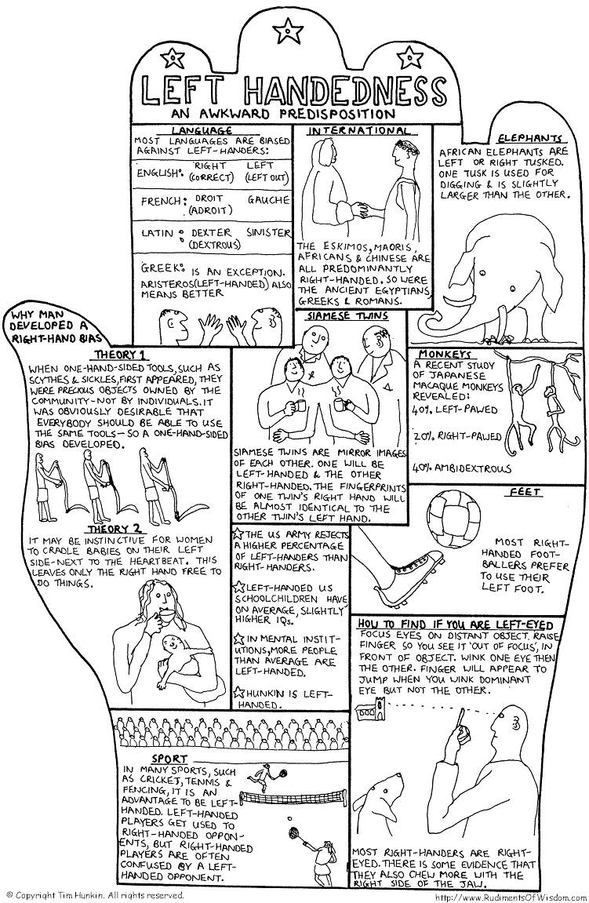
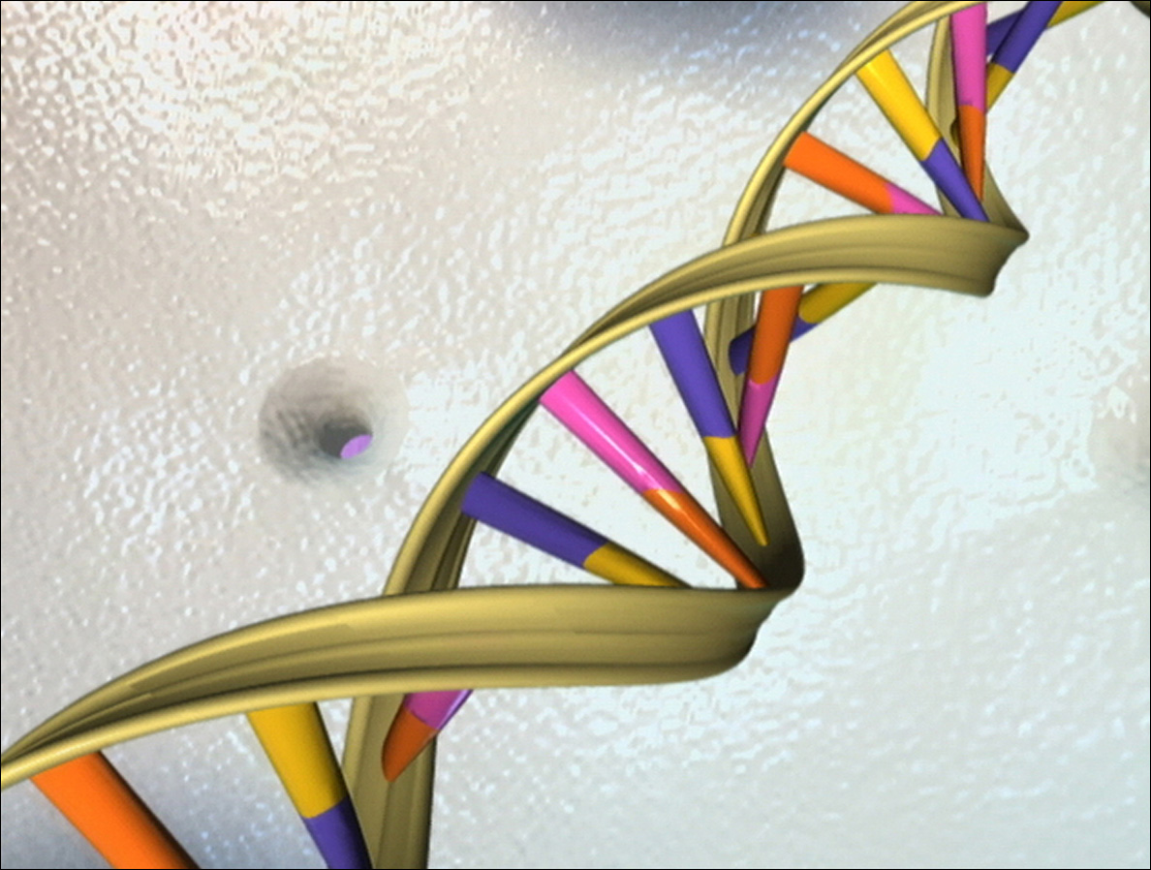
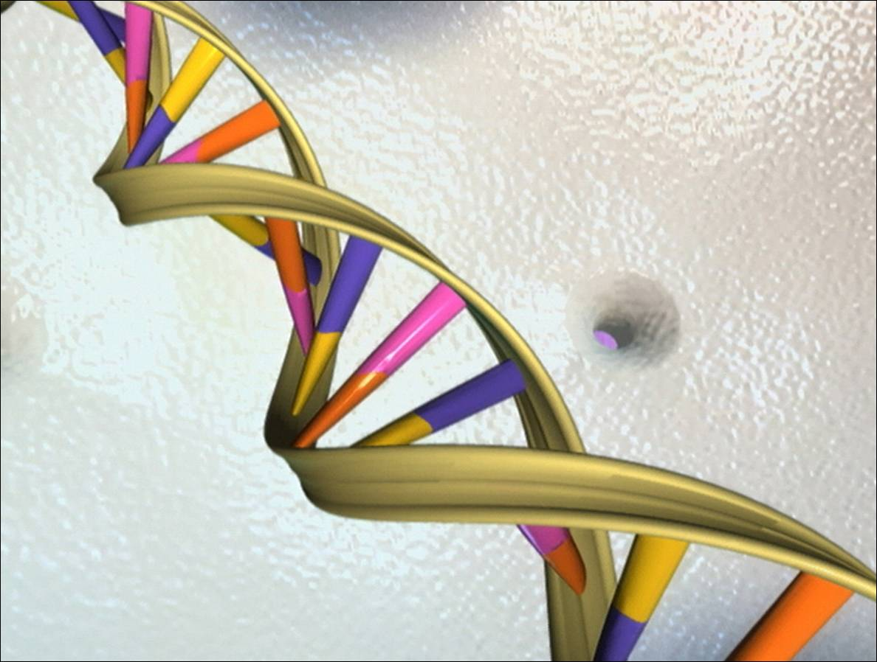
IF CPT is conserved, how about C, P, and T?
Parity is often violated in the macroscopic world:
 | Strongly Left-sided | Strongly Right-sided | Mixed Sided
Handedness | 5% | 72% | 22%
Footedness | 4% | 46% | 50% (?)
Eyedness | 5% | 54% | 41%
Earedness | 15% | 35% | 60%
Porac C & Coren S. Lateral preferences and human behavior. New York: Springer-Verlag, 1981
About 25% of the population drives on the
left side: why ?
In ancient societies people walked (rode) on the left to have their sword closer to the middle of the street (for a right-handed man) !?
The DNA is an oriented double helix
Two right-handed polynucleotide chains that are coiled about the same axis:

Slide 10
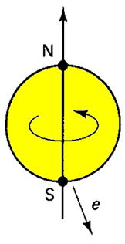
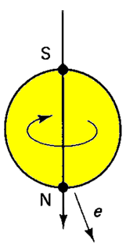
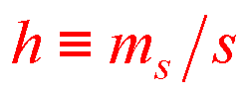
Parity transformation
Parity is not conserved in weak interactions
If it were, the electrons of Wu’s experiment would have come out in equal numbers in both directions “north” and “south”
P
Helicity
h = +1 right-handed
h = -1 left-handed
Massive particle: helicity is not Lorentz-invariant.
Massless particle: helicity is Lorentz-invariant.
From experiment,
photons are right-handed and left-handed;
neutrinos are left-handed;
antineutrinos are right-handed.

Slide 11
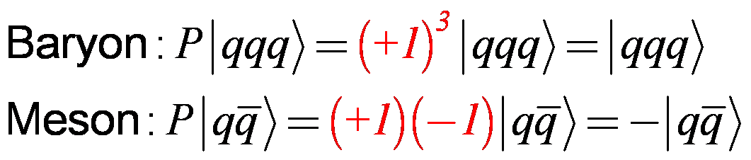
Parity transformation
According to QFT, the parity of fermion must opposite to that of the corresponding antiparticle, while the parity of a boson is the same as its antiparticle.
We take the quarks to have positive intrinsic parity, so the antiquarks are negative.
Parity is a multiplicative quantum number

Slide 12
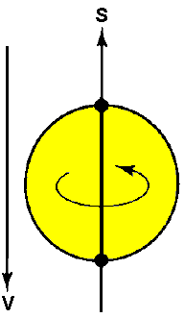
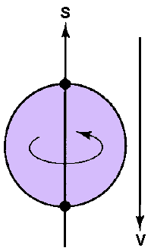
Charge conjugation
Charge conjugation is not a symmetry of the weak interactions
When applied to a neutrino (left-handed), C gives a left-handed antineutrino
C

Slide 13
Charge conjugation
Photon is the quantum of the electromagnetic field, which changes sign under charge conjugation
System consisting of a spoin -1/2 particle and its antiparticle in a configuration with orbital angular momentum l and total spin s, constitutes and eigenstate of C with eigenvalue (-1)^{l+s}
Vector meson (l=0, s=1): C= -1
Ex: ϕ, ω, ρ⁰
Pseudoscalar meson (l=0, s=0): C=+1
Ex: π, η, η’

Slide 14
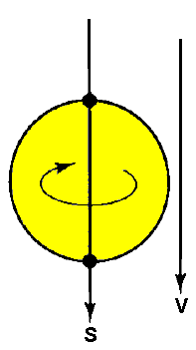
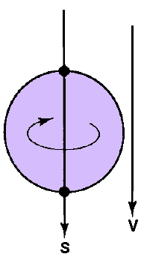
CP symmetry
CP symmetry: conserved in weak interactions (at least until 1964)
C
P

Slide 15
Example: CP conservation in pions
π – meson decay violates maximally C and P invariance,
but is invariant under CP
ν
μ⁺
ν
μ⁺
π⁺
P
π⁺
ν spin
μ spin
ν spin
μ spin
YES
C
CP
C
NO
NO
YES
ν
μ–
ν
μ–
π–
P
π–
ν spin
μ spin
ν spin
μ spin
Pion decay to electrons suppressed (helicity suppression)
If leptons were massless they would only exist in left-handed form (as neutrinos)
In this case, the pion wouldn’t decay to leptons
The relatively smaller mass of the electron makes this decay almost prohibited (suppressed by a factor of 10⁴)
π– → μ– + ν decay

Slide 16
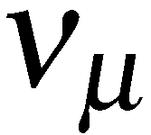

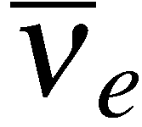
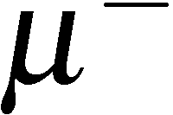
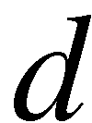
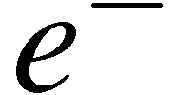
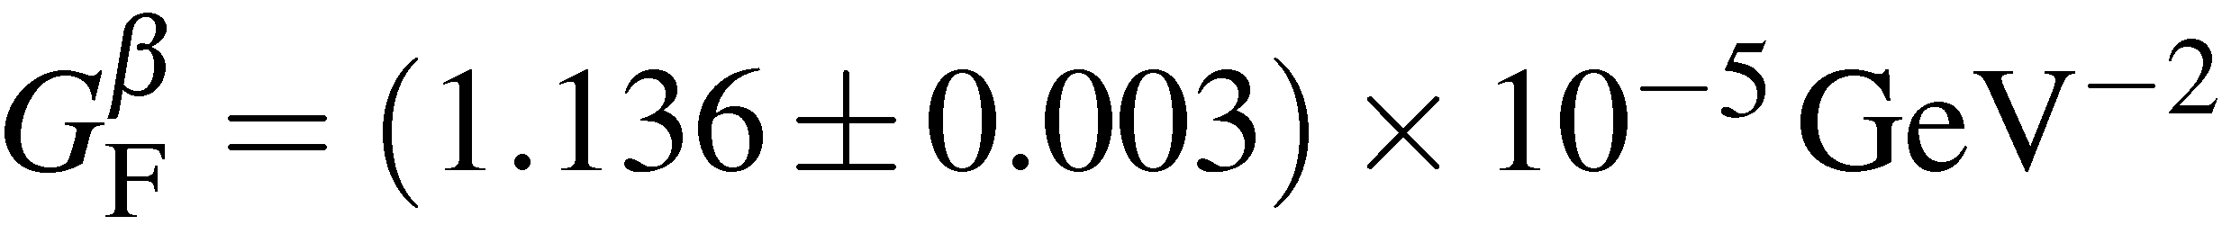

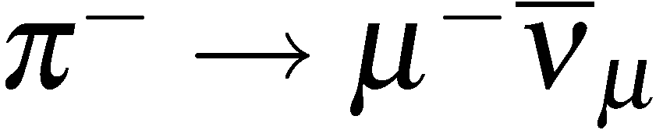
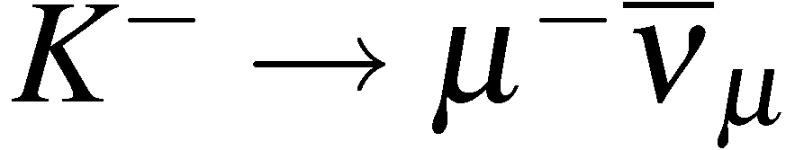
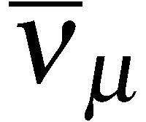

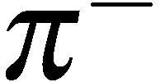
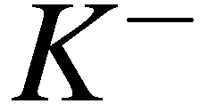
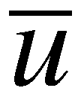
The weak interaction of quarks
A couple of puzzles in early 1960’s
Slightly different values of G_{F} measured in μ decay and nuclear β decay:
In addition, certain hadronic decay modes are observed to be suppressed, e.g.
compare and . Kaon decay rate suppressed factor 20
compared to the expectation assuming a universal weak interaction for quarks.

Slide 17
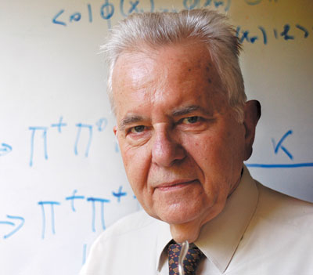
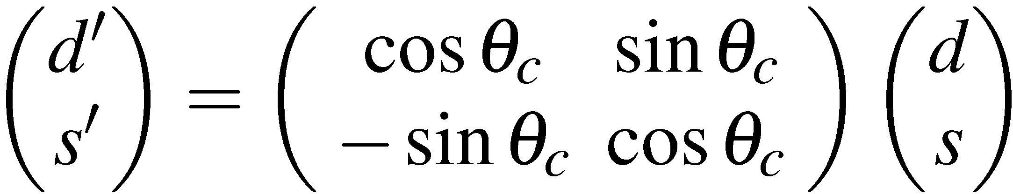
Cabibbo model
Both observations explained by Cabibbo hypothesis (1963): weak eigenstates are different from mass eigenstates, i.e. weak interactions of quarks have same strength as for leptons but a u-quark couples to a linear combination of s and d
N. Cabibbo

Slide 18
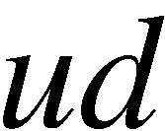
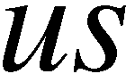
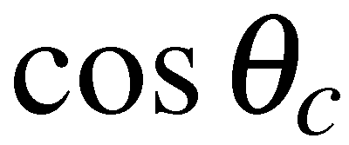
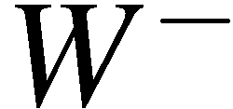
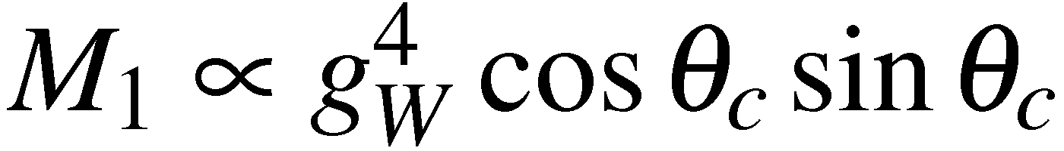
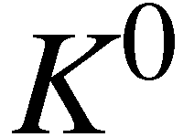
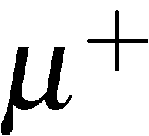
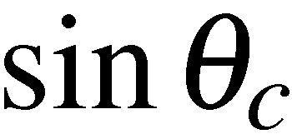
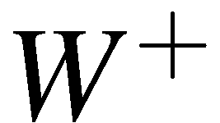
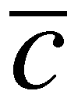
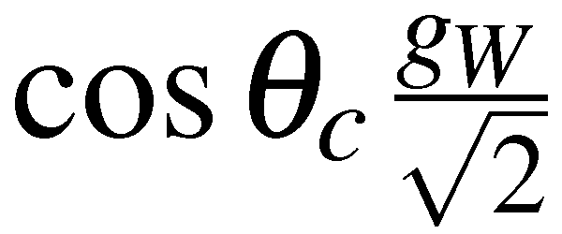
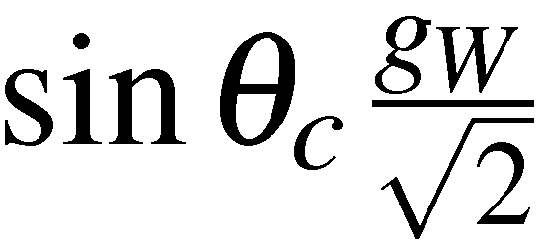
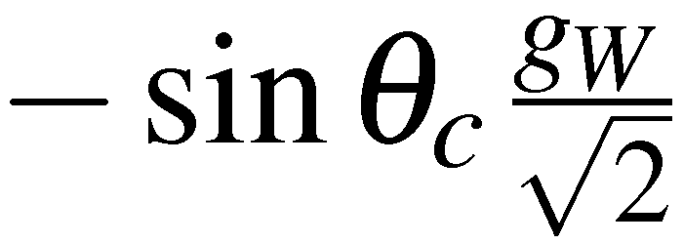
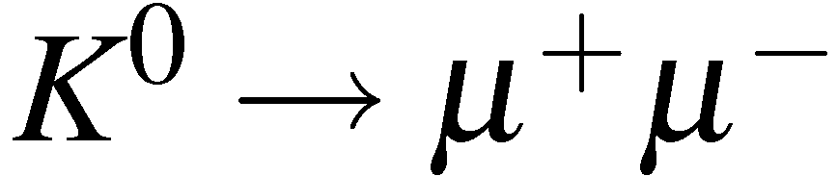
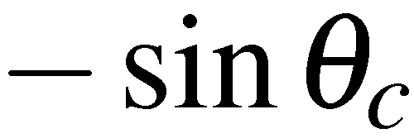
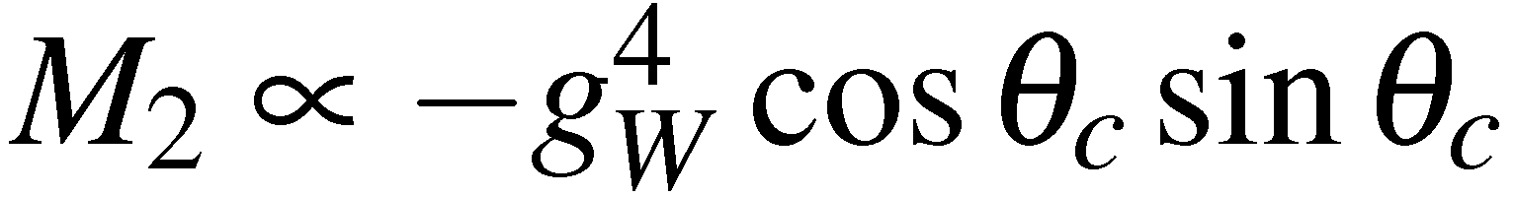

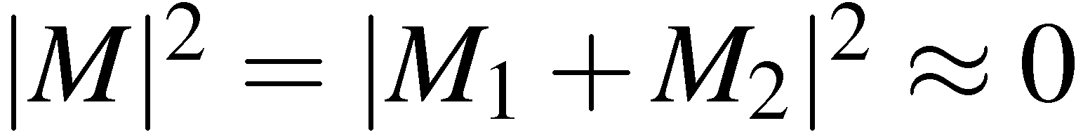
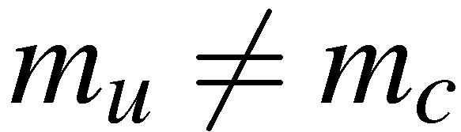
Kaons in weak interactions
In the weak interaction have couplings between both and which
implies that neutral mesons can decay via box diagrams, e.g.
d
s
Historically, the observed branching
was much smaller than predicted
Led Glashow, Illiopoulos and Maiani to postulate existence of an extra quark
- before discovery of charm quark in 1974. Weak interaction couplings become
Gives another box diagram for
d
Same final state so sum amplitudes
s
Cancellation not exact because

Slide 19


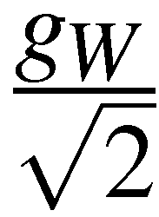
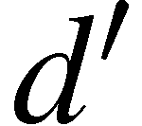
Kaons in weak interactions
i.e. weak interaction couples different generations of quarks
(The same is true for leptons e.g. e⁻ ν₁ , e⁻ ν₂ , e⁻ ν₃ couplings – connect different generations)

Slide 20
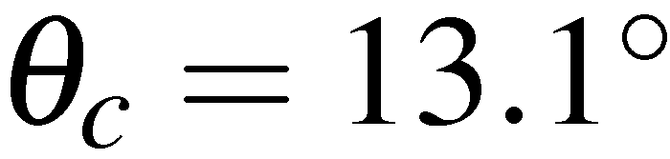
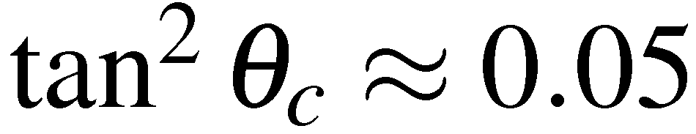



Kaons in weak interactions
This explain the observations on the previous pages with
Kaon decay suppressed by a factor of relative to pion decay
Hence expect

Slide 21






The neutral Kaon system
Neutral Kaons are produced copiously in
strong interactions, e.g.
Neutral Kaons decay via the weak interaction
The Weak Interaction also allows mixing of neutral kaons via “box diagrams”
d
s
d
s
s
d
s
d
This allows transitions between the strong eigenstates states
Consequently, the neutral kaons propagate as eigenstates of the overall strong
+ weak interaction; i.e. as linear combinations of

Slide 22


The neutral Kaon system
The linear combination of is called “K-short” and the “K-long”
These states have approximately the same mass
But very different lifetimes:
How do we get K_{s} and K_{L} ?

Slide 23






K0 – K0 mixing
The wave-function for a single particle with lifetime evolves with time as:
which gives the appropriate exponential decay of
The wave-function satisfies the time-dependent wave equation:
(A1)
For a bound state such as a the mass term includes the “mass” from
the weak interaction “potential”
Sum over
intermediate
states j
d
d
The third term is the 2nd order
term in the perturbation expansion
corresponding to box diagrams
resulting in
c
t
s
s

Slide 24




K0 – K0 mixing
The total decay rate is the sum over all possible decays
Density of final states
Because there are also diagrams which allow mixing need to
consider the time evolution of a mixed stated
(A2)

Slide 25



K0 – K0 mixing
The time dependent wave-equation of (A1) becomes
(A3)
the diagonal terms are as before, and the off-diagonal terms are due to mixing.
d
s
c
t
s
d

Slide 26



K0 – K0 mixing
The off-diagonal decay terms include the effects of interference between
decays to a common final state
In terms of the time dependent coefficients for the kaon states, (A3) becomes
where the Hamiltonian can be written:
Both the mass and decay matrices represent observable quantities and are
Hermitian
Furthermore, if CPT is conserved then the masses and decay rates of the
and are identical:

Slide 27




K0 – K0 mixing
Hence the time evolution of the system can be written:
(A4)
To solve the coupled differential equations for a(t) and b(t), first find the
eigenstates of the Hamiltonian (the K_{L} and K_{S}) and then transform into
this basis. The eigenvalue equation is:
(A5)
Which has non-trivial solutions for
with eigenvalues
The eigenstates can be obtained by substituting back into (A5)

Slide 28





K0 – K0 mixing
Define
Hence the normalised eigenstates are
We can identify the general eigenstates as the long and short lived neutral kaons:

Slide 29





K0 – K0 mixing
Substituting these states back into (A2):
with
Now consider the time evolution of
Which can be evaluated using (A4) for the time evolution of a(t) and b(t):

Slide 30




K0 – K0 mixing
Hence:
with
and

Slide 31






K0 – K0 mixing
Following the same procedure obtain:
with
and
In matrix notation we have
Solving we obtain
Hence in terms of the K_{L} and K_{S} basis the states propagate as independent
particles with definite masses and lifetimes (the mass eigenstates). The time
evolution of the neutral kaon system can be written
where A_{L} and A_{S} are constants

Slide 32







CP eigenstates
The and are closely related to eigenstates of the combined charge
conjugation and parity operators: CP
The strong eigenstates and have
with
The charge conjugation operator changes particle into anti-particle and vice versa
similarly
The + sign is purely conventional, could
have used a - with no physical consequences
Consequently
i.e. neither or are eigenstates of CP

Slide 33





CP eigenstates
Form CP eigenstates from linear combinations:
Note, in the limit where are real in (A5), the eigenstates correspond to the CP eigenstates K₁ and K₂.

Slide 34








Decays of CP eigenstates
Neutral kaons often decay to pions (the lightest hadrons)
The kaon masses are approximately 498 MeV and the pion masses are
approximately 140 MeV. Hence neutral kaons can decay to either 2 or 3 pions
Decays to Two Pions:
Conservation of angular momentum 
The is an eigenstate of

Slide 35






Decays of CP eigenstates
Neutral kaons often decay to pions (the lightest hadrons)
The kaon masses are approximately 498 MeV and the pion masses are
approximately 140 MeV. Hence neutral kaons can decay to either 2 or 3 pions
Decays to Two Pions:
as before
Here the C and P operations have the identical effect
Hence the combined effect of
is to leave the system unchanged
Neutral kaon decays to two pions occur in CP even (i.e. +1) eigenstates

Slide 36







Decays of CP eigenstates
Decays to Three Pions:
Remember L is
magnitude of angular
momentum vector
Conservation of angular momentum:

Slide 37



Decays of CP eigenstates
Decays to Three Pions:
Again
Hence:
The small amount of energy available in the decay,
means that the L>0 decays are strongly suppressed by the angular momentum
barrier effects (recall QM tunnelling in alpha decay)
Neutral kaon decays to three pions occur in CP odd (i.e. -1) eigenstates

Slide 38









Decays of CP eigenstates
If CP were conserved in the weak decays of neutral kaons, would expect decays
to pions to occur from states of definite CP (i.e. the CP eigenstates , )
CP EVEN
CP ODD
Expect lifetimes of CP eigenstates to be very different
For two pion decay energy available:
For three pion decay energy available:
Expect decays to two pions to be more rapid than decays to three pions due to
increased phase space
This is exactly what is observed: a short-lived state “K-short” which decays to
(mainly) to two pions and a long-lived state “K-long” which decays to three pions
In the absence of CP violation we can identify
with decays:
with decays:

Slide 39
Neutral Kaon decays to pions
Consider the decays of a beam of
The decays to pions occur in states of definite CP
with decays:
with decays:
Expect to see predominantly two-pion decays near start of beam
and predominantly three pion decays further downstream
Log Intensity
At large distance left
with pure K_{L} beam
Distance from K⁰ production

Slide 40





Neutral Kaon decays to pions
To see how this works algebraically:
Suppose at time t=0 make a beam of pure
Put in the time dependence of wave-function
K_{S} mass:
K_{S} decay rate:
NOTE the term ensures the K_{S} probability density decays exponentially
i.e.

Slide 41




Neutral Kaon decays to pions
Hence wave-function evolves as
Writing
and
The decay rate to two pions for a state which was produced as
which is as anticipated, i.e. decays of the short lifetime component K_{S}

Slide 42










Neutral Kaon system to leptons
Neutral kaons can also decay to leptons
Note: the final states are not CP eigenstates
which is why we express these decays in terms of
Neutral kaons propagate as combined eigenstates of weak + strong
interaction i.e. the . The main decay modes/branching fractions are:
Leptonic decays are more likely for the K-long because the three pion decay
modes have a lower decay rate than the two pion modes of the K-short

Slide 43
CP violation in the Kaon system
So far we have ignored CP violation in the neutral kaon system
Identified the K-short as the CP-even state and the K-long as the CP-odd state
with decays:
CP = +1
with decays:
CP = -1
At a long distance from the production point a beam of neutral kaons will
be 100% K-long (the K-short component will have decayed away). Hence,
if CP is conserved, would expect to see only three-pion decays.

Slide 44





CP violation in the Kaon system
In 1964 Fitch & Cronin observed 45 decays
in a sample of 22700 kaon decays a long distance from the production point
J. Cronin, V. Fitch
Weak interactions violate CP
CP is violated in hadronic weak interactions, but only at the level of 2 parts in 1000
K_{L} to pion BRs:

Slide 45


CP violation in the Kaon system

Slide 46






CP violation in the Kaon system
Two possible explanations of CP violation in the kaon system:
i) The K_{S} and K_{L} do not correspond exactly to the CP eigenstates K₁ and K₂
with
In this case the observation of is accounted for by:
CP = +1
CP = -1

Slide 47


CP violation in the Kaon system
ii) and/or CP is violated in the decay
CP = -1
CP = -1
Parameterised by
CP = +1

Slide 48
CP violation in the Kaon system
Where does CP comes from ?
K_{L} (CP ≈ -1) = K₂ (CP = -1) + ε • K₁ (CP = +1) → ππ (CP = +1)
indirect CP-violation
(through mixing)
direct CP-violation (in the decay)
indirect CP-violation: must be same for π⁰π⁰ and for π⁺π⁻
direct CP-violation: may be different for π⁰π⁰ and for π⁺π⁻
“Superweak model” possible (introducing a 5th interaction)
Explanation only through “Standard Model”

Slide 49

Direct vs Indirect CP violation
Frequent
Rare
R ≠ 1: direct CP-violation exists
Experimentally both known to contribute to the mechanism for CP violation in the
kaon system but i) dominates:
NA48 (CERN)
KTeV (FermiLab)

Slide 50



Kaon experiments
CERN
NA48 1997-2001 K_{L},K_{S}
NA48/1 2000,2002 K_{S}
NA48/2 2003-2004 K±
Newer
Experiments
Fermilab
KTeV: 1997,1999 K_{L},K_{S}
Frascati - DaФne
KLOE > 2000 K_{S} ,K_{L} ,K±

Slide 51


Experimental results on ε’/ε
As of 2005
(16.7 ± 2.6) × 10⁻⁴
Final Result (1997-2001)
Half Statistics ( (1996-1997)
Re(ε′/ε)

Slide 52



CP violation in semi-leptonic decays
If observe a neutral kaon beam a long time after production (i.e. a large distances)
it will consist of a pure K_{L} component
Decays to must come from the component, and decays to
must come from the component

Slide 53
CP violation in semi-leptonic decays
Results in a small difference in decay rates: the decay to is
0.7 % more likely than the decay to
This difference has been observed and thus provides the first direct
evidence for an absolute difference between matter and anti-matter.
It also provides an unambiguous definition of matter which could, for example,
be transmitted to aliens in a distant galaxy
“The electrons in our atoms have the same charge as those emitted
least often in the decays of the long-lived neutral kaon”

Slide 54
CP Violation in the Early Universe
Why CP violation is important for our existence
Very early in the universe might expect equal numbers of baryons and anti-baryons
However, today the universe is matter dominated (no evidence for anti-galaxies, etc.)
No antinuclei (e.g. Antihelium) seen in cosmic rays (limit from BESS)
No significant (diffuse) cosmic gamma rays from nucleon-antinucleon annhilation in the boundary between matter and antimatter regions
matter
Big Bang
antimatter
Balloon-borne Superconducting Solenoidal (BESS) spectrometer

Slide 55


Slide 56

CP Violation in the Early Universe
From “Big Bang Nucleosynthesis” obtain the matter/anti-matter asymmetry
observed to be ~ 1 ×10^{–10} < η < 6 ×10^{–10}
i.e. for every baryon in the universe today there are photons
Early in the universe need to create a very small asymmetry between baryons and anti-baryons
e.g. for every 10⁹ anti-baryons there were 10⁹+1 baryons
baryons/anti-baryons annihilate
1 baryon + ~10⁹ photons + no anti-baryons

Slide 57



CP Violation in the Early Universe
A. Sakharow
To generate this initial asymmetry three conditions must be met (Sakharov, 1967):
Baryon number violation, i.e. is not constant
 C and CP violation, if CP is conserved for a reaction which generates
a net number of baryons over anti-baryons there would be a CP
conjugate reaction generating a net number of anti-baryons
 Departure from thermal equilibrium, in thermal equilibrium any baryon
number violating process will be balanced by the inverse reaction
Baryogenesis: processes that produced an asymmetry between baryons and anti-baryons in the very early universe

Slide 58
CP Violation in the Early Universe
Problem: The anti-nucleon densities in thermal equilibrium
High temperature plasma (thermal equilibrium)
Decay
Departure from thermal equilibrium
Freezing out
For n_{B}/n_{γ}=10^{–10}, one has: T ~ 40 MeV, but T_{freeze-out} ~ 20 MeV ⇒ n_{B}/n_{γ}=10^{–18} ☹
Significant η > 0 already at T > 40 MeV

Slide 59
CP Violation in the Early Universe
Suppose equal amounts of matter (X) and antimatter (X)
X decays to
A (baryon number NA) with probability p
B (baryon number NB) with probability (1-p)
X decays to
A (baryon number NA) with probability p
B (baryon number NB) with probability (1-p)
Generated baryon asymmetry:
requires

Slide 60
CP Violation in the Early Universe
CP Violation is an essential aspect of our understanding of the universe
A great deal of experimental evidence for CP violation in the weak interactions of quarks
Firstly found in the Kaon system, continues with the studies of other mesons
A natural question is whether the SM of particle physics can provide the necessary CP violation to explain the the matter – anti-matter asymmetry of the universe
Current measurements show that CP violation in the SM is not sufficient
Beyond the SM physics would be necessary to accommodate this CP asymmetry
There are two places in the SM where CP violation enters: the PMNS matrix (neutrinos) and the CKM matrix (quarks)
To date CP violation has been observed only in the quark sector

Slide 61
Tuesday lectures
Date | Topic | Student
Sept 27 | Positron (p9) Muon (p29) Pion (p34) | Nici Alex Kevin
Oct 4 | Unstable particles (p65 or p71) Anti-p (p87) or Anti-n (p94) | Lukas Oliver
Oct 11 | Omega-(p144) Parity violation in beta (p163) Parity violation in pions (165) | Magnus Nici Alex
Oct 18 | K-long (p197) CP violation (p206) | Kevin Lukas
Oct 25 | Tau lepton J and Psi Charm meson | Oliver Magnus Nici
Nov 2 | Quarks SLAC Gluons TASSO Jets UA2
Date | Topic | Student
Nov 8 | Upsilons CLEO b
Nov 15 | Neutral currents Discovery of the W boson Neutrino species
Nov 22 | Discovery of the top quark Top quark mass measurement
Nov 29 | ARGUS CDF (or Belle/Babar)
Dec 6 | Solar Atmospheric
Dec 20 | Higgs discovery by ATLAS or CMS Measurements of Higgs boson properties
From pages from R. Cahn and G. Goldhaber book if available

